Slide 1
From Sheets to Success: Reliable, Reproducible, yet Flexible Production Pipelines
Katrina Brock useR 2021
Notes:
Images: (1) yellow “groovy” serif sunbasket wordmark, (2) sun in splendor logo
Voiceover: Hi,
I’m Katrina. I work at Sunbasket. Today, I’m going to tell you about how I used R to to drastically increase the reliability of our forecast process.
Next slide.

Slide 2
Agenda
1 Problem statement
2 Solution 2.1 Cutting down the is web of dependencies and moving more of the forecast into code 2.2 Fully reproducible and automatically validated forecast
3 Impact
Notes:
(no image)
Slide 2
I’ll start by telling you about our forecasting challenges.
Then I’ll share how we solved these challenges by rearchitecting our forecast pipeline using R.
Finally, I’ll talk about the impact to of these changes.

Slide 3
Problem

Slide 4
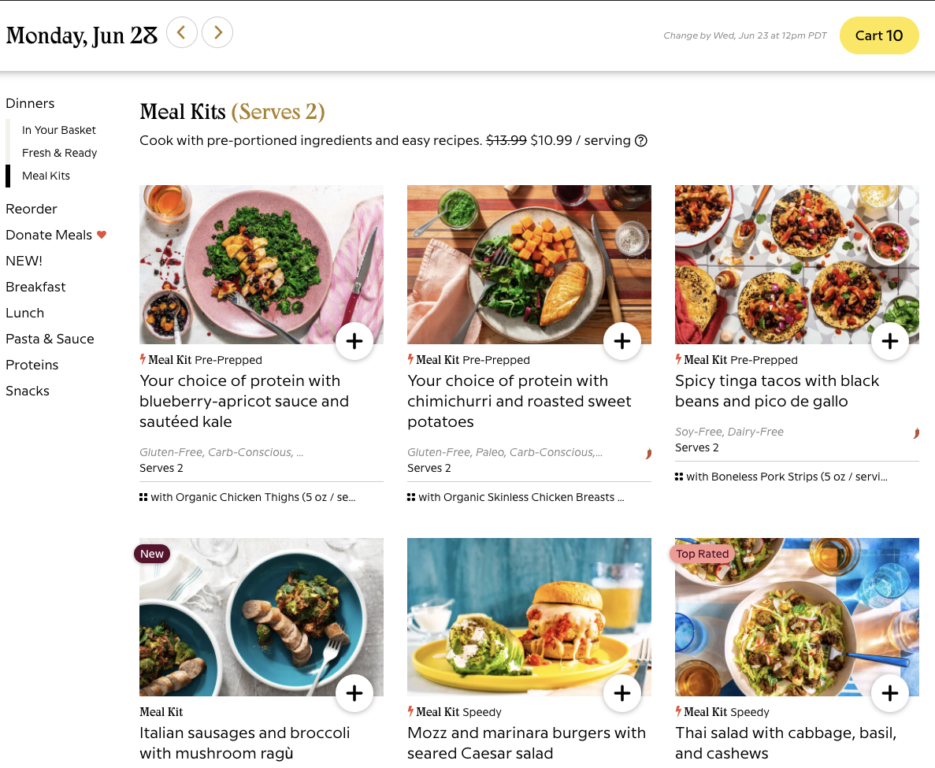
Forecast Challenge
How much to buy of each ingredient of each meal?
Every day data team produces a file with items and quantities. Purchases are made based on these numbers
Notes:
Image
Screenshot of desktop e-commerce web UI. (Similar to https://sunbasket.com/menu)
Main header: “Monday, Jun 28” with right and left
Lefthand NAV: Dinners, Reorder, Donate Meals, NEW! Breakfast, Lunch, Pasta & Sauce Proteins, Snacks
Most of the page has six images of prepared food each with a title: 1) Your choice of protein with blueberry-apricot sauce and sautéed kale 2) Your choice of protein with chimichurri and roasted sweet potatoes 3) Spicy tinga tacos with black beans and pico de gallo 4) Italian sausages and broccoli with mushroom ragù 5) Mozz and marinara burgers with seared Caesar salad 6) Thai salad with cabbage, basil, and cashews
Voiceover
Slide 4
Sunbasket is an ecommerce food company. This is what our customer-facing website looks like. There are different meals on the menu every week which we create in-house. And our challenge is to predict how much of each item will be ordered each week. We publish this in a file that gets fed into procurement systems and buyers purchase thousands of dollars worth of perishable ingredients based on these numbers.
Next slide.

Slide 5
🙂 If the file is accurate, we buy exactly what we need to fulfill our customers orders.
🙁 If the file is inaccurate, we either get stuck with product we can't sell or have to scramble and pay premium prices to get what we need at the last minute.
😱 If the file is missing, procurement has no way of knowing what exactly we will need and how much.
Notes:
(no image, text only) Slide 5
There is a substantial financial impact of both over and under forecast.
And if the forecast process fails entirely, then the buyers have no guidance what to buy and how much.
So how do we generate this forecast?

Slide 6
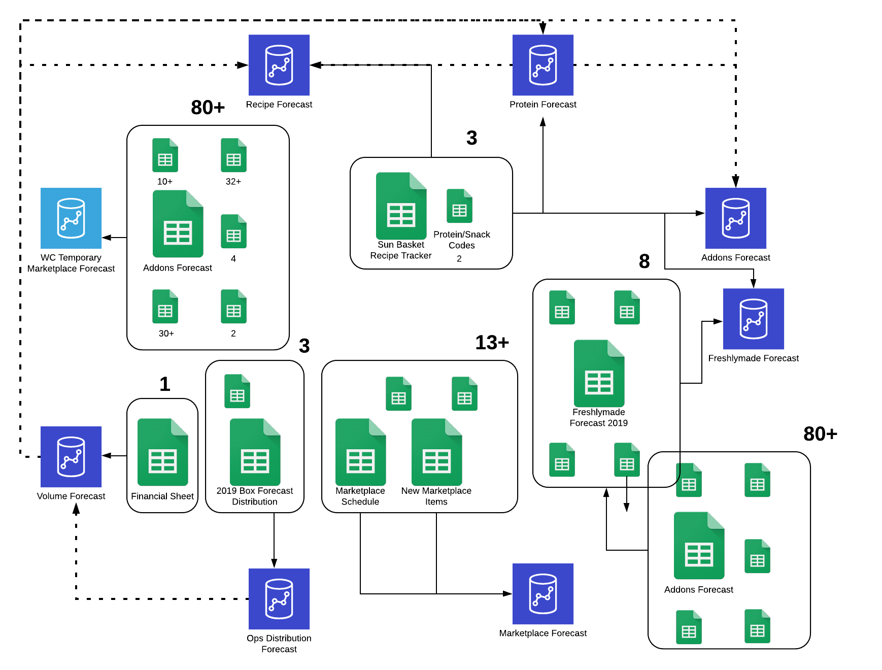
BEFORE
Known google sheet dependendencies of subbasket forecast process
Notes:
Image
Flow chart littered with 8 database icons, 7 groups of google sheet icons (~25 google sheet icons), and many arrows connecting them. One of the groups of google sheet icons is labeled 13+. Two of the groups have the number 80+. Icons and arrows cover most of the slide.
Voiceover
Slide 6
This file used to be produced primarily using spreadsheets. Info from different teams across the company was combined with a lot for formulas and spreadsheet linking.
This diagram represents 100-200 google sheets that are all inputs to the process.
So literally thousands of cells and a mistaken edit in any one them could result in a breakage. Also, formulas constantly needed to be manually maintained and extended to show more future dates.

Slide 7
2. Solution

Slide 8
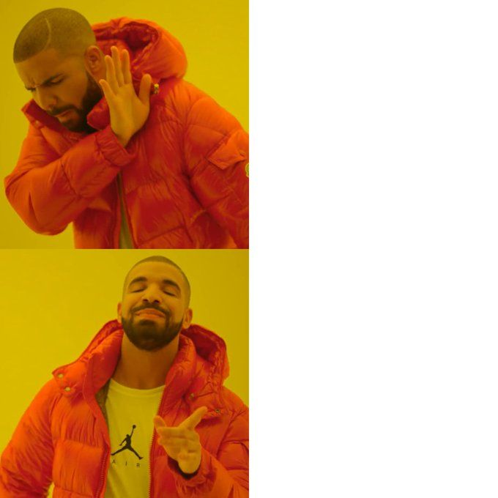
2.1 Move majority of the logic to R and SQL
=IMPORTRANGE("https://docs.google.com/spreadsheets/d/really_long_googlesheet_url/", "Recipe Tracker!A:DP")
SELECT *
FROM ds_metrics.lt_st_combined_blended_forecast_01a
Notes:
Image
Drake meme. Drake distains an IMPORTRANGE spreadsheet formula. Drake approves of a SELECT * SQL query. Voiceover
Slide 8
Our first step to get this situation under control was to start moving the logic to R and SQL.
In this version of the forecast process, we had a handful of scripts that ran in sequence. Each script would
read from google sheets or a database table
do some basic manipulations
then write back to another google sheet or database table.
The nice part was, everything we did put into code was now under version control. However, with this method,
Although, cut down on some google sheet usage. We were still relying on quite a few sheets formulas to execute business logic.
Also, when we ran these scripts, the intermediates were overwritten. There was no way to test changes locally without potentially impacting production job.
We also had no way to definitively troubleshoot. If the job was failed and the then later succeed, there was no way to know the state of the system during the failure.

Slide 9
2.2 Forecast Pipeline - Overview
8 stages
📷 Input Snapshot (Custom YAML definition)
✔️ Snapshot Check (validate)
🛠️ Feature Building - drake plan
✔️ Feature Check - (validate)
🏃‍♀️ Run Model - Custom YAML definition
✔️ Raw Prediction Check - (validate)
🛠️ Prediction Post Processing - drake plan
✔️ Processed Prediction Check - YAML validate rules
Notes:
(text only)
Voiceover
Slide 9
To solve these issues, I created a system where each forecast went through a standardized set of steps listed.
Each step has pre-defined inputs and outputs, and every output gets automatically checked at the subsequent stage.
Note (not spoken)
For forecasts with no ML or statistical model, there is a simplified flow. Feature build, model run, and prediction processing are combined into one step.

Slide 10
2.2 Forecast Pipeline - The How (YAML config + Validate)
FAKE_PRODUCT_LINE:
ship_by: ship_week
forecast_future_weeks: 3
model_type: 'business_rules'
ship_to: ['procurement_daily']
inputs:
mtcars:
owner: Katrina
type: table
db: default
schema: ds_sandbox
table: mtcars
snapshot: true
rules:
-
expr: mpg > 10
name: enough mpg
label: mpg > 10
- &rule_i_want_to_copy
expr: cyl %% 2 == 0
name: cylinder is multiple of 2
label: cylinder is multiple of 2
Notes:
(text only)
Voiceover
Slide 10
What what does this look like in practice?
We have one large yaml file with most of the forecast configuration. For each product line, there is a separate forecast and a separate entry in that file. Here, I’m showing one example entry.
On the left, we’ve defined what dates we will need to forecast for and where we need to send the output.
Under inputs, we’ve defined what we need for the first two stages: input snapshot and input check. We have:
Exactly where to find the data
Who is responsible for maintaining that data
And checks defined by rules. Here we’re using syntax defined by the validate package.
These checks are especially important for those human-provided inputs.
We use checks like these to check the output of each stage, not just inputs.
Notes (not spoken)
If this were a statistical or ML model, there would be a few more things we would need to include.
You also may notice that we’re using yaml anchor on one of the rules. This feature of yaml allows us to copy by reference any rule or input from one pipeline to another.

Slide 11
2.2 Forecast Pipeline - The How (Drake Plan)
FORECAST_BUSINESS_RULES_PLANS <- list(
"FAKE_PRODUCT_LINE" = drake::drake_plan(
inputs = pull_input_data_from_snapshots(ds_env, forecast_slug),
...
predictions = counts_by_dc_week[, .(
quantity = count,
item = item_id,
location = dc,
forecast_date = x,
date_tag = date_tag
)],
storage_result = store_predictions(predictions, ds_env, forecast_slug, processed = TRUE)
),
...
)
Notes:
(text only)
Slide 11
In addition to what’s in the YAML, there are a few stages in each pipeline where we need to execute arbitrary business logic.
For these, encapsulate R code into a drake plan.
Each of these plans starts with pulling input data from from snapshots. This is the one and only place where we can get input data. We do not run arbitrary sql queries or api calls during plan. Therefore, given the input data, the result is deterministic. All the input data that we get from this function has been checked and stored in case we need to troubleshoot later.
In the middle we put the actual business logic.
At the end of each plan, we store the output (either features or predictions). We use helper functions to ensure they are stored consistently so they can also be checked.

Slide 12
3. Impact

Slide 13
Benefits
Process Reliability - 7d MTBF (including input check failures)
Derisked from unexpected inputs
Derisked from Google Sheet shenanigans
Faster Dev Cycles
Derisked from development work infecting production pipeline
R runtime is faster than SQL or Google sheets (if you sheet network is big enough, you
2-3 hour process down to 10 min
Troubleshooting Capability
With snapshots, we have invented a time machine
Notes:
(no images, only text)
Slide 13
The number one benefit of this system reliability. Daily flow of the forecast is not longer interrupted google formula issues. If there is an issue with a manual input, we know exactly which input was the issue.
We’ve also sped up development time. Since the majority of business logic is in R, rerunning is relatively quick and does not risk interrupting the production process.
Finally, with snapshot we have no more mysteries about any past the state of the system. We know exactly what code and what input data went in each run of the pipeline.
Ultimately, with all this free time, data scientists can focus more on building models instead of troubleshooting process issues.

Slide 15
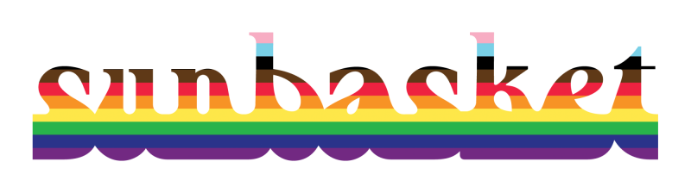
Thanks for joining!
Contributors to this work… Ajay - our fearless leader, gave me this project and the space to work on it
Koji - responsible for initial move of forecast logic to R, #1 forecast creator, user/guinea pig of the forecast system
Oren - created many of the features used for forecasting
Gergely - provided advice and feedback on design
Creators of packages…
dbr
validate
drake
R yaml
Notes:
Image: Sunbasket wordmark in progress pride flag colors.
Thank you all for joining!

